Slide 1

Exception Handling

Slide 2
Agenda
What is Exception and Error
Types of Exceptions
Handling Exceptions

Slide 3


E & E
What is an Exception
What is it?
To better understand exceptions and exception handling, let’s make a real-life comparison.
  Imagine that we order a product online, but while en-route, there’s a failure in delivery. A good company can handle this problem and gracefully re-route our package so that it still arrives on time.
  Likewise, in Java, the code can experience errors while executing our instructions. Good exception handling can handle errors and gracefully re-route the program to give the user still a positive experience.
Error : An Error “indicates serious problems that a reasonable application should not try to catch.” Some of the examples of errors are Out of memory error or a System crash error.

Slide 4
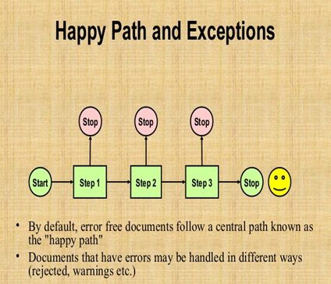

Why use it?

Slide 5
Exception Hierarchy
Throwable(String message)
getMessage():String
printStackTrace() :void
Throwable
Error
Exception

Slide 6
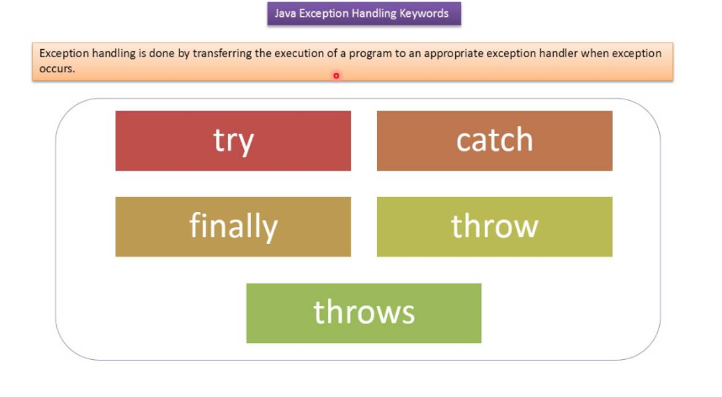
Exception Handling Keywords

Slide 7
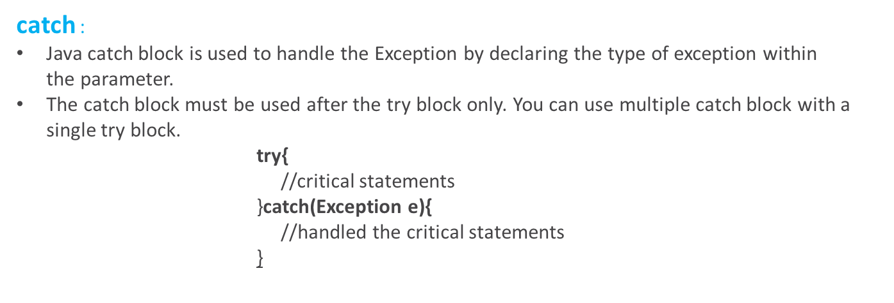
Exception Handling Keywords
try :
try is a block. The try block is used to enclose the code that might throw an exception

Slide 8
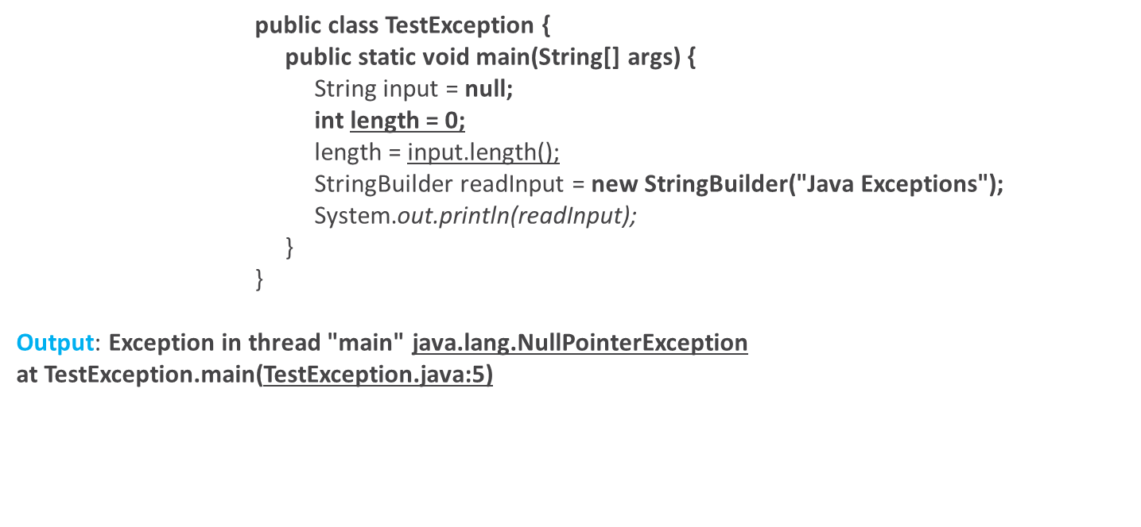
Advantage of Exception Handling

Slide 9
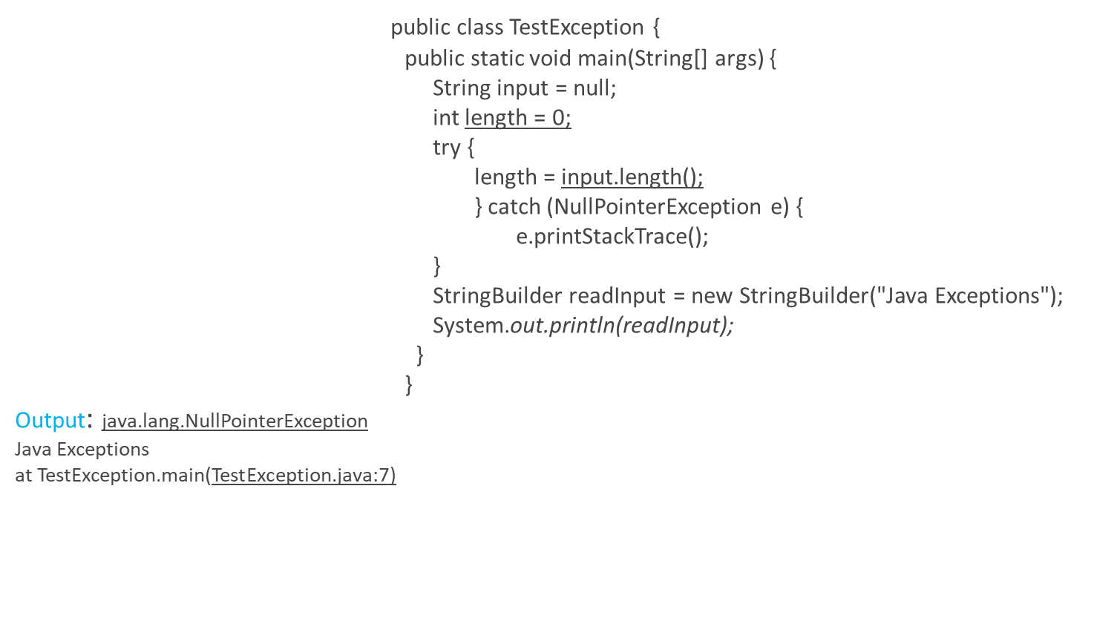
Advantage of Exception Handling

Slide 10
QUIZ

Slide 11
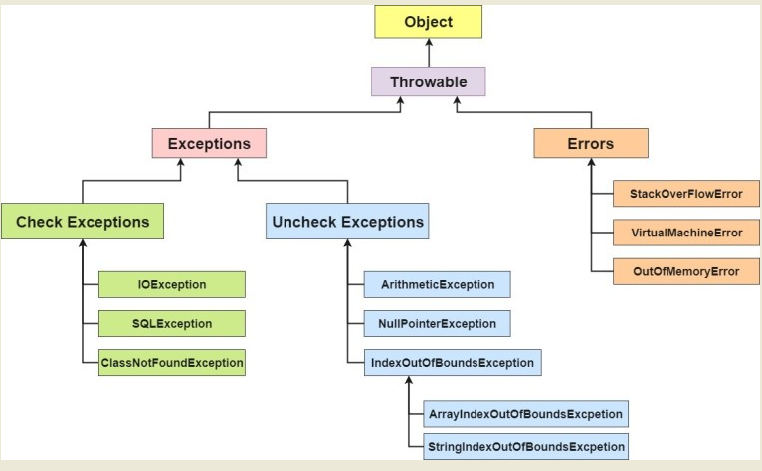
Detailed Exception Hierarchy

Slide 12
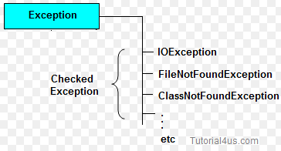
Checked Exception
Checked: are the exceptions that are checked at compile time. If some code within a method throws a checked exception, then the method must either handle the exception or it must specify the exception using throws keyword.
Example:
The following Java program that opens file at location “C:\test\.txt” and prints the first three lines of it.

Slide 13
Checked Exception Example
      import java.io.BufferedReader;
      import java.io.FileReader;
      public class TestReadFile {
      public static void main(String[] args) {
      FileReader file=new FileReader("C:\\test\\testData.txt");
      BufferedReader fileReader=new BufferedReader(file);
      for(int counter=0;counter<3;counter++){
      System.out.println(fileReader.readLine());
      }
      fileReader.close();
      }
      }

Slide 14
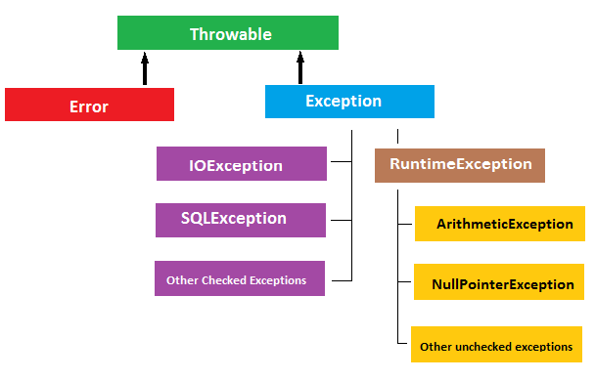
Unchecked Exception
Unchecked are the exceptions that are not checked at compiled time.
The classes which inherit RuntimeException are known as unchecked exceptions

Slide 15
UnChecked Exception
public class TestUnChecked {
      public static void main(String[] args) {
      try {
      int result=10/0;
      } catch (ArithmeticException e) {
      System.out.println(e.getMessage());
      e.printStackTrace();
      }
      System.out.println("Rest of the code");
      }
      }
Output: / by zero
Rest of the code
java.lang.ArithmeticException: / by zero
at TestUnChecked.main(TestUnChecked.java:6)

Slide 16
Best practices
      public class TestUnchecked {
      public static void main(String[] args) {
      int i=10;
      int j=0;
      int result;
      if(j!=0){
      result=i/j;
      }
      System.out.println("Rest of the code");
      }
      }
Output:
Rest of the code

Slide 17
Java finally block
Java finally block is a block that is used to execute important code such as closing connection, stream etc.
Java finally block is always executed whether exception is handled or not.
Java finally block follows try or catch block.
Syntax:
finally{
}

Slide 18
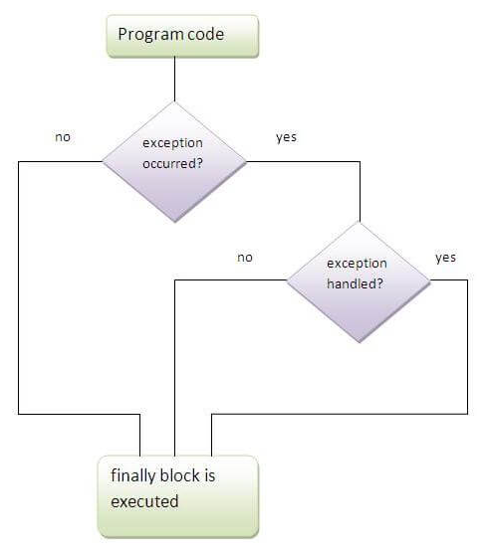
Java finally block

Slide 19
finally block Example
class TestFinallyBlock{
public static void main(String args[]){
try{
int data=25/5;
System.out.println(data);
}
catch(NullPointerException e){System.out.println(e);}
finally{System.out.println("finally block is always executed");}
System.out.println("rest of the code...");
}
}

Slide 20
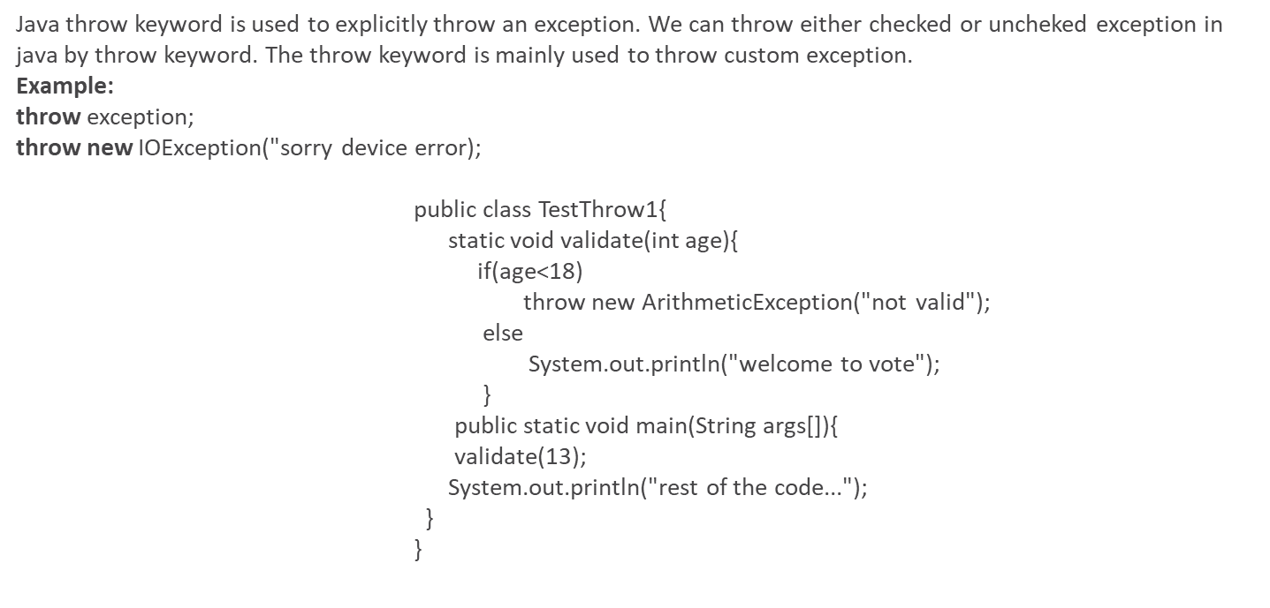
Java throw block

Slide 21
QUIZ

Slide 22
References
https://docs.oracle.com/javase/tutorial/essential/exceptions/index.html

Slide 23
Task
https://www.hackerrank.com/challenges/java-exception-handling/problem
Link : https://epa.ms/PEP2019-EXCEPTIONS

Slide 24
        Thank You

